Slide 1
Predicting the Severity of Car Accident
Sumit Kumar
October 20, ‘20

Slide 2
Introduction
Road Accidents are very common now
Given Circumstances
High Traffic
Weather, Light and Road Conditions
Driver’s condition while driving
Problem Statement:
“ To predict the Severity of a road accident, given different attributes of the situation, like coordinates, number of vehicles, road condition, light condition, drug usage, alcohol usage during driving, not paying attention. “
Stakeholders
Traffic Authority
Woke Individuals

Slide 3
Data
Feature Selection
['SEVERITYCODE', 'ADDRTYPE', 'INTKEY', 'COLLISIONTYPE', 'PERSONCOUNT', 'PEDCOUNT', 'PEDCYLCOUNT', 'VEHCOUNT', 'JUNCTIONTYPE', 'INATTENTIONIND', 'UNDERINFL', 'WEATHER', 'ROADCOND', 'LIGHTCOND', 'SPEEDING', 'HITPARKEDCAR']
Data Cleansing and Preprocessing
One hot encoding
Categorical Values
Data interpretations and Visualization

Slide 4
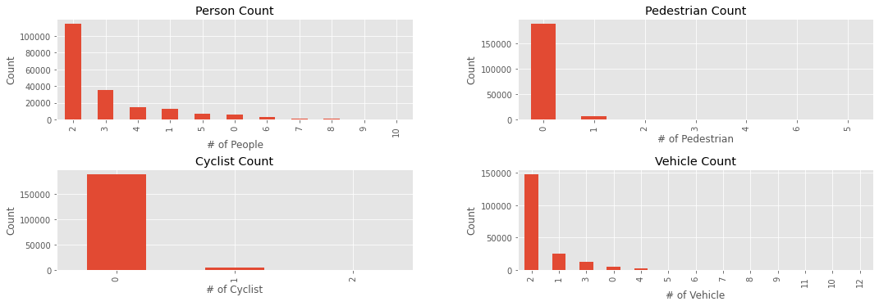

Slide 5
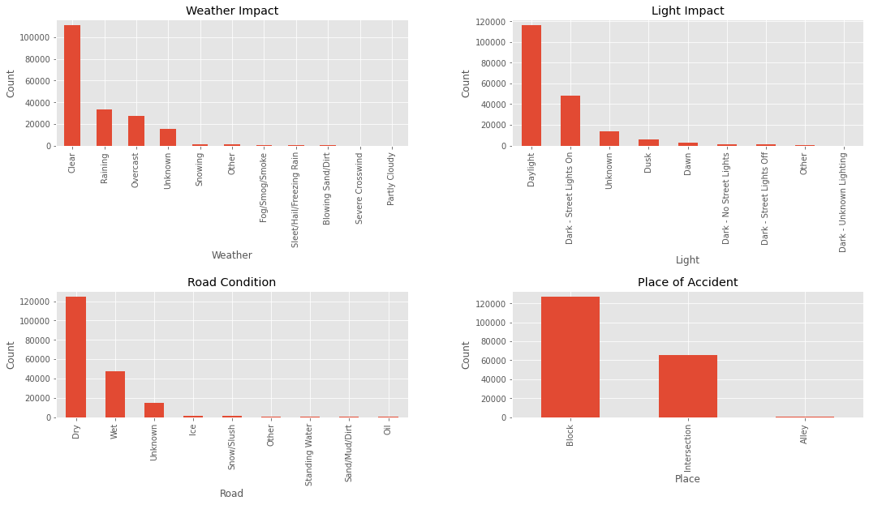

Slide 6
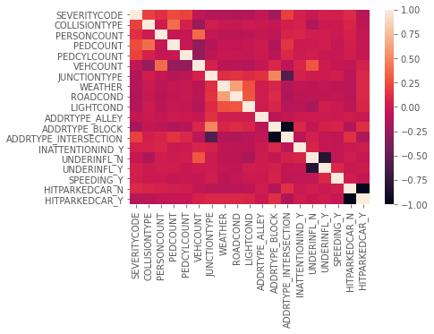
Methodology
Correlation between Selected Features

Slide 7
The Machine Learning Models used in the Project:
Decision Tree
Gaussian Naive Bayes
Nearest Neighbors
Neura; Networks

Slide 8
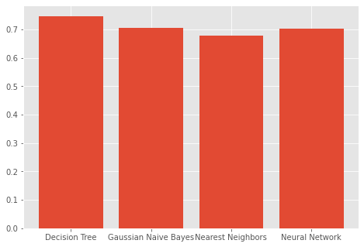
Result
Accuracy of Models are as follows:
Decision Tree: 0.747
Gaussian naive Bayes: 0.704
Nearest Neighbors: 0.697
Neural Network: 0.703

Slide 9
Conclusion and Follow Ups
The best accuracy was 74.7%
More Training is required
A lt of scenarios covered in data, need more extensive data
Better efforts to collect data

Slide 10
Thank You

